Slide 1
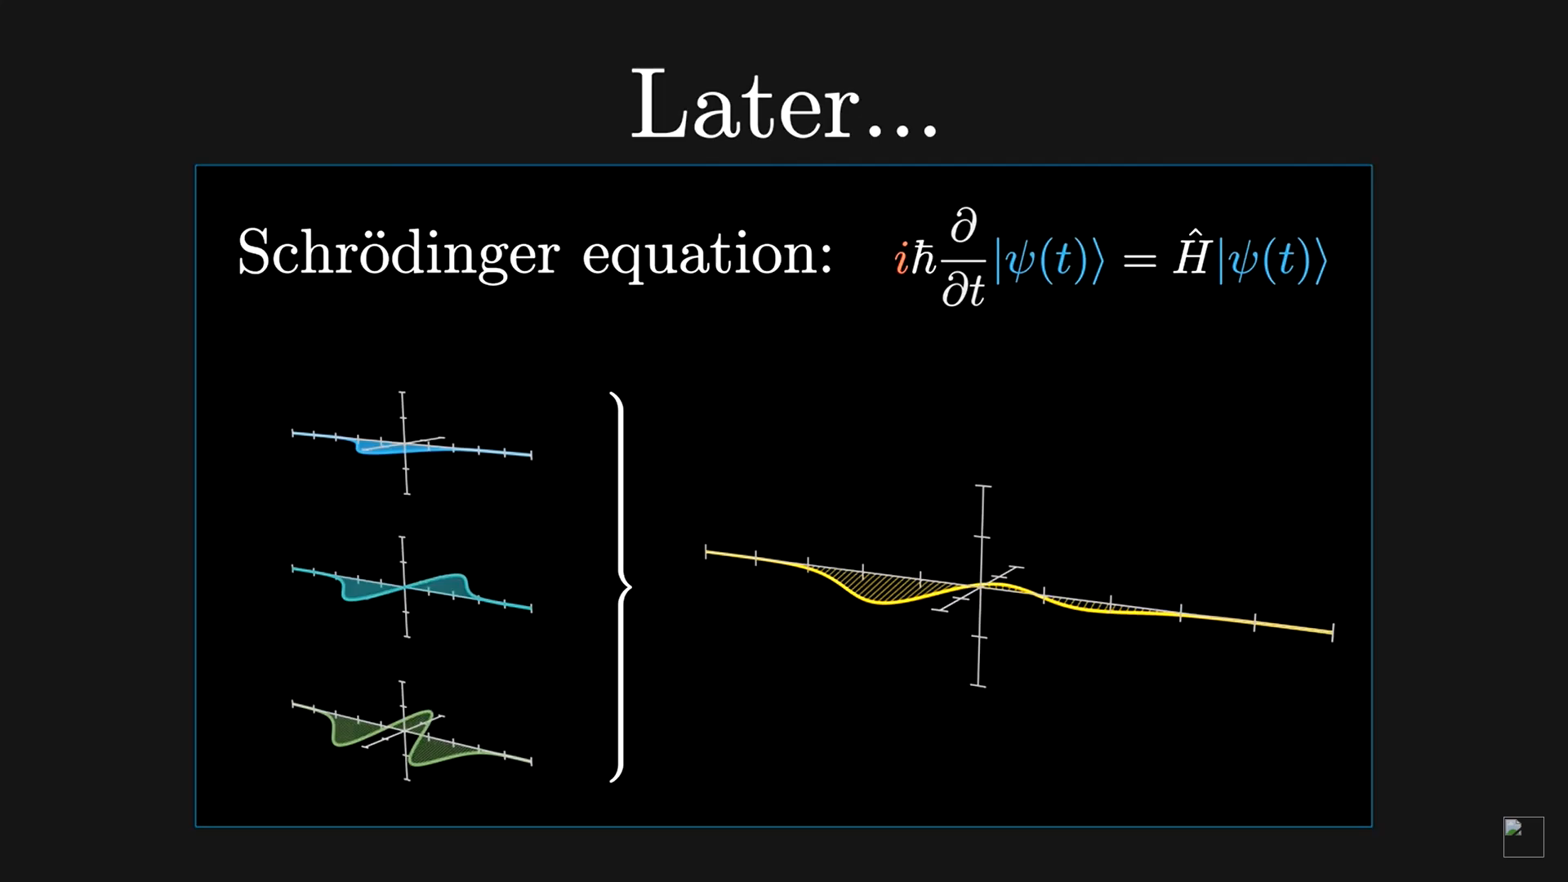
Motivation

Slide 2
Outline
Versions + Installation
Quickstart
Setting the default configuration
Options
Doc & existing content
Your own animation!
Jupyter slides
Manim-slides

Slide 3
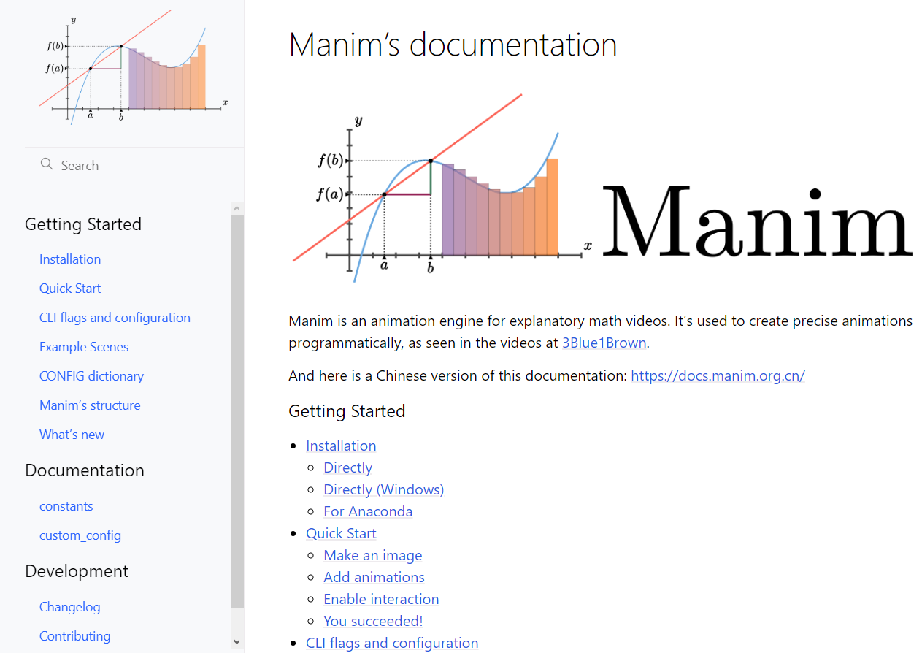
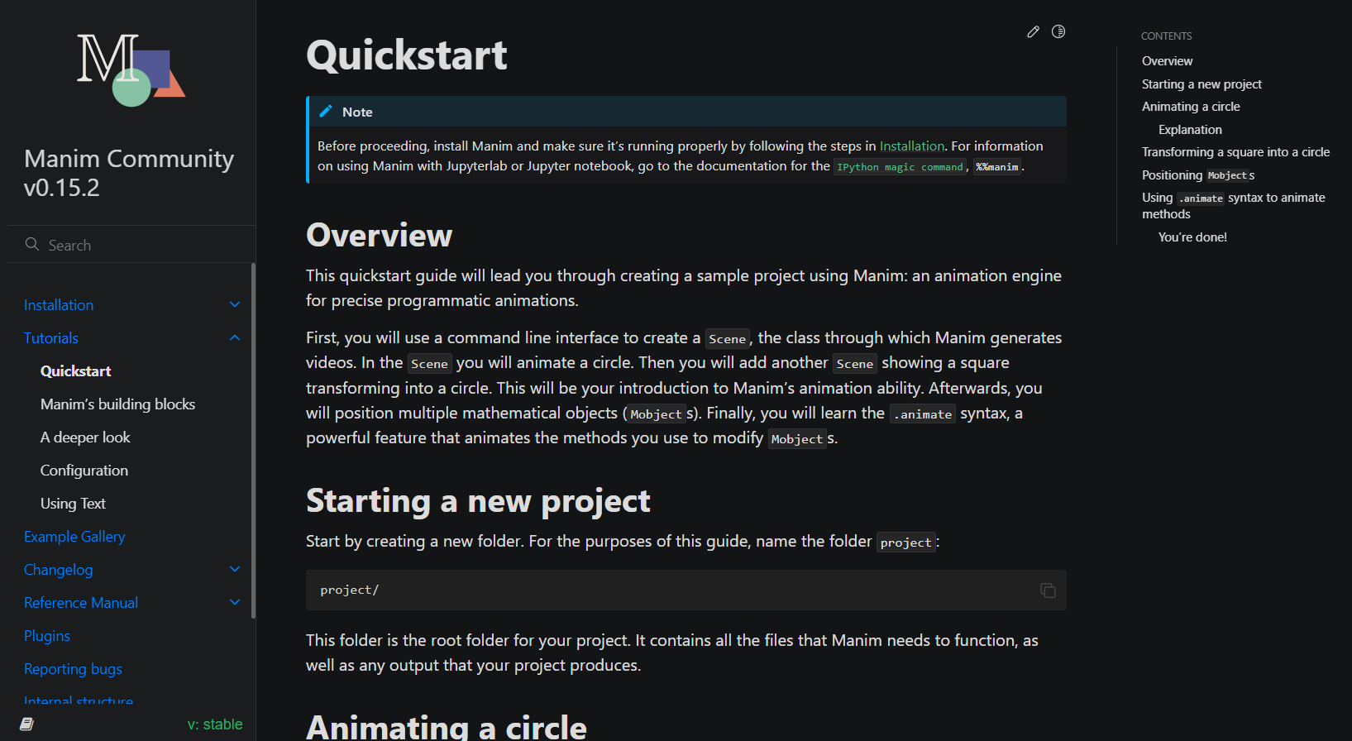
Versions + Installation
There are 2 versions of manim:
3b1b historical version -> Manimlib
3b1b.github.io/manim
Community version -> Manim
https://docs.manim.community/en/stable

Slide 4
Versions + Installation
There are 2 versions of manim:
3b1b historical version -> Manimlib
pip install manimgl
Community version -> Manim
pip install manim
Possibility to install via Github repository directly, see docs.
Don’t forget dependencies: ffmpeg, (optional) miktex

Slide 5
Quickstart - Manimlib
Run
manimgl example_scenes.py OpeningManimExample
Or
Copy the following snippet from https://3b1b.github.io/manim/getting_started/quickstart.html :
from manimlib import *
class SquareToCircle(Scene):
def construct(self):
circle = Circle()
circle.set_fill(BLUE, opacity=0.5)
circle.set_stroke(BLUE_E, width=4)
self.add(circle)
And run this in the command window:
manimgl start.py SquareToCircle

Slide 6
Default configuration
In default_config.yml, better to manually choose:
- temporary_storage: “MyPath"
- background_color: "#000000"
- window_position: OO
- full_screen: True

Slide 7
Sanity check
class ShowLine(Scene):
def construct(self):
line = Line()
self.add(line)
If the line does not show and you are using Windows, you probably have a too old GPU. See https://github.com/3b1b/manim/discussions/1546
Imperfect solution: go to mobjet/types/vectorized_mobject.py, increase fill_opacity.

Slide 8
Quickstart - Manim

Slide 9
Conclusion
Code your animations
Highly tunable
Templates from YouTube channels:
3Blue1Brown
Reducible

